Slide 1
Day 4 Woo hoo!
Notes:
Zoe up front: 9-9:15
Take sharing about assignment of attracting something- (have them stand, give their name and share.)
Take several stories then ask them to turn to someone ner them and share more.
Briefly explain the rest of the day, and how we’ll be busy to the very end.
9:15-9:45
Explanation of Ultimate Truth Statement and demo, done in segments
Pass to Linz…

Slide 2
Relationship Remedy part 1
Transforming contentious relationships
into Healthy, Happy, Harmonious Relationships

Slide 3
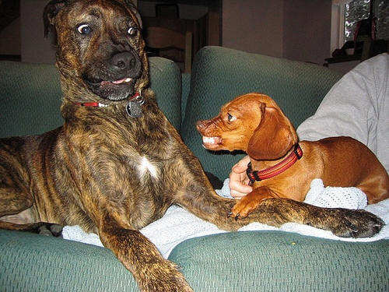
“I’m only going to tell you this one more time pal: stay away from my dame!”
Notes:
Zoe up front: 9-9:15
Take sharing about assignment of attracting something- (have them stand, give their name and share.)
Take several stories then ask them to turn to someone ner them and share more.
Briefly explain the rest of the day, and how we’ll be busy to the very end.
9:15-9:45
Explanation of Ultimate Truth Statement and demo, done in segments
Pass to Linz…

Slide 4
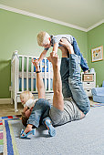
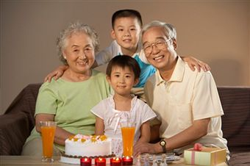
friends
committed couples
siblings
father / child
mother / child
grandparents / family
professional

Slide 5
Relationship Remedy part 1
1. Pick a challenging, current relationship

Slide 6
Relationship Remedy part 1
2. define negative feelings or
circumstances about him / her
anger, resentment
frustration, disappointment
cheating, lying, irresponsible
fighting, antagonistic, self-centered

Slide 7
Relationship Remedy part 1
3. Do a Reversal Set-up
Even though this anger and resentment towards ________, is causing a rift between us, there’s a part of me that doesn’t want to let it go – and I love myself anyway.

Slide 8
Relationship Remedy part 1
4. Bundle and tap away ALL negative emotions, & troubling events

Slide 9
Include….
need to punish him / her… unfairness
wanting to be right / righteous indignation
wishing it could have been different!

Slide 10
Dyads for relationship problems

Slide 11
Relationship Remedy part 2
1. do 2-3 rounds of gratitude tapping on his / her good qualities
2. make a Wish List for this type of relationship…POSITIVE PHRASING ONLY
3. tap on attracting this type of person …not for your person to change

Slide 12
Relationship Remedy part 2
- I am attracting a kind, accepting and patient boss
I deserve and am attracting a ideal partner
who respects me, is affectionate, supportive
(and empties the dishwasher everyday)

Slide 13
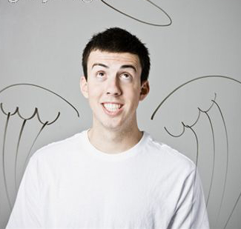
Relationship Remedy part 2
I’m attracting a friend ( or _________ )
who honors our secrets, keeps commitments,
and accepts me unconditionally
I want a son / daughter who is respectful, helpful and motivated

Slide 14
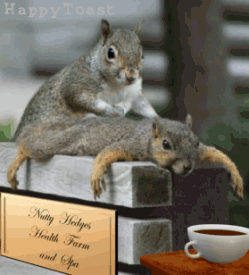
People may think you’re a little squirrely, but you deserve a full time masseuse

Slide 16
Doing awesome phone sessions
Simply tell them what to say and where to tap

Slide 17
Doing Pro EFT™ by phone is EASY
you can do sessions from anywhere, anytime
do sessions in your jammies
develop clients around the world
you don’t have to shave your legs

Slide 18
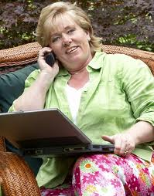
Skills to develop:
great intuition
ability to hear what hasn’t been said
ability to tune into the client’s mood
judge client’s emotions (knowing the difference between laughter and tears)
listen with all of your senses

Slide 19
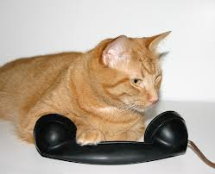
Other things you need:
that sounds purrr-fect
a sense of humor
the willingness to be wrong
sensitivity to their needs
the ability to write fast

Slide 20
www.LK1.AudioAcrobat.com
Things you need to do:
1) subscribe to Audio Acrobat!
2) order 3-way calling from your phone company
3) get inclusive long distance from your telephone company

Slide 21
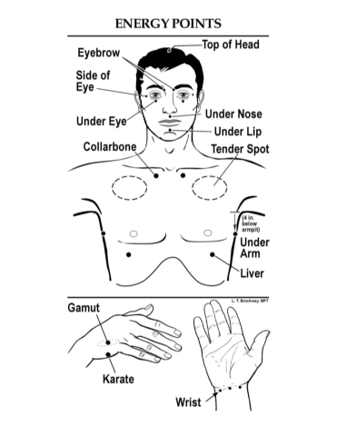
4. E-mail client a confirmation and
instructions to:
have a quiet place to tap
have a headset
have tapping points in front of them

Slide 22
dyads to practice phone sessions

Slide 23
lunch break

Slide 24
time for your final exam!
put workbooks, notes and other classroom material under your table.
turn your test in when completed, before you leave the room.
all tests must be turned in by 1:40

Slide 25
time for the final exam
option 1: start and complete the test before going to lunch
option 2: go get lunch now and bring it back to eat during the test
option 3: do lunch now then return to start the test

Slide 26
scoring the tests

Slide 28
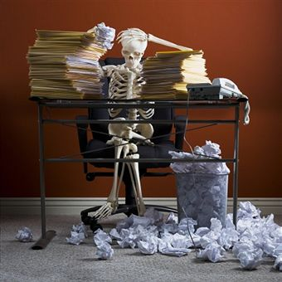
UTS for stuck issues
weight
procrastination
clutter
time issues (habitually late)
general stuckness
- can’t go forward
- can’t get started
- can’t finish anything
“why bother” syndrome

Slide 29
UTS for being stuck
1) write a simple sentence about your goals: I want to get everything done on a timely basis
2) describe how your life will be different:
Life will be easier, will be more productive, good energy, more choices, sleep well, more time
Notes:
Write down how your life will be different when you get your desire (more time, increased energy, more options, freedom, etc.)
2) Add in the emotions, ie. how you will FEEL differently (happy, accomplished, peace of mind, joy in life, security, confidence, etc.)
3) Define their UTS
4) Give believability a rating 1 to 10, with 10 that you own it and believe it now.
5) Identify what’s in the way of owning the statement now
Set aside UTS and work on obstacle in the way; fear, don’t deserve it, can’t figure out how to make it happen, etc.
1) Set aside UTS and work on obstacle in the way; fear, don’t deserve it, can’t figure out how to make it happen, etc.

Slide 30
UTS for being stuck
3) how will you feel when you have what you want:
feel good about self, secure, confident, happy, peace of mind, joy, freedom, freedom, sense of accomplishment, relief
Notes:
Write down how your life will be different when you get your desire (more time, increased energy, more options, freedom, etc.)
2) Add in the emotions, ie. how you will FEEL differently (happy, accomplished, peace of mind, joy in life, security, confidence, etc.)
3) Define their UTS
4) Give believability a rating 1 to 10, with 10 that you own it and believe it now.
5) Identify what’s in the way of owning the statement now
Set aside UTS and work on obstacle in the way; fear, don’t deserve it, can’t figure out how to make it happen, etc.
1) Set aside UTS and work on obstacle in the way; fear, don’t deserve it, can’t figure out how to make it happen, etc.

Slide 31
UTS for being stuck
4) put it all together in a positive statement with gratitude:
thank you U for allowing me to get everything done on time. I feel good about myself, have lots of energy, have a sense of accomplishment, earning more $, etc.
Notes:
Write down how your life will be different when you get your desire (more time, increased energy, more options, freedom, etc.)
2) Add in the emotions, ie. how you will FEEL differently (happy, accomplished, peace of mind, joy in life, security, confidence, etc.)
3) Define their UTS
4) Give believability a rating 1 to 10, with 10 that you own it and believe it now.
5) Identify what’s in the way of owning the statement now
Set aside UTS and work on obstacle in the way; fear, don’t deserve it, can’t figure out how to make it happen, etc.
1) Set aside UTS and work on obstacle in the way; fear, don’t deserve it, can’t figure out how to make it happen, etc.

Slide 32
UTS for being stuck
5) give a believability or ownership
rating to your UTS (10 is perfect)
Notes:
Write down how your life will be different when you get your desire (more time, increased energy, more options, freedom, etc.)
2) Add in the emotions, ie. how you will FEEL differently (happy, accomplished, peace of mind, joy in life, security, confidence, etc.)
3) Define their UTS
4) Give believability a rating 1 to 10, with 10 that you own it and believe it now.
5) Identify what’s in the way of owning the statement now
Set aside UTS and work on obstacle in the way; fear, don’t deserve it, can’t figure out how to make it happen, etc.
1) Set aside UTS and work on obstacle in the way; fear, don’t deserve it, can’t figure out how to make it happen, etc.

Slide 33
part 2 of the UTS
6) identify obstacles in the way of ownership: fears of; failure, rejection, attention
beliefs of: it’s too hard, deprivation, need to
know how to do it
7) give the obstacles a pull number from 10 to 1
Notes:
Write down how your life will be different when you get your desire (more time, increased energy, more options, freedom, etc.)
2) Add in the emotions, ie. how you will FEEL differently (happy, accomplished, peace of mind, joy in life, security, confidence, etc.)
3) Define their UTS
4) Give believability a rating 1 to 10, with 10 that you own it and believe it now.
5) Identify what’s in the way of owning the statement now
Set aside UTS and work on obstacle in the way; fear, don’t deserve it, can’t figure out how to make it happen, etc.
1) Set aside UTS and work on obstacle in the way; fear, don’t deserve it, can’t figure out how to make it happen, etc.

Slide 34
part 2 of the UTS
8) do reversal neutralization on obstacles:
ET these fears and beliefs get in my way, there’s a part of me that doesn’t want to let go of them. And I love and accept myself anyway.
Notes:
Write down how your life will be different when you get your desire (more time, increased energy, more options, freedom, etc.)
2) Add in the emotions, ie. how you will FEEL differently (happy, accomplished, peace of mind, joy in life, security, confidence, etc.)
3) Define their UTS
4) Give believability a rating 1 to 10, with 10 that you own it and believe it now.
5) Identify what’s in the way of owning the statement now
Set aside UTS and work on obstacle in the way; fear, don’t deserve it, can’t figure out how to make it happen, etc.
1) Set aside UTS and work on obstacle in the way; fear, don’t deserve it, can’t figure out how to make it happen, etc.

Slide 35
part 2 of the UTS
9) tap away the obstacles (on the meridian points)
10) when obstacles are at a zero, go back and reassess ownership of UTS
11) troubleshoot if not at a 10
tap away any resistance to owning the UTS
keep tapping until the ownership is at a 10
Notes:
Write down how your life will be different when you get your desire (more time, increased energy, more options, freedom, etc.)
2) Add in the emotions, ie. how you will FEEL differently (happy, accomplished, peace of mind, joy in life, security, confidence, etc.)
3) Define their UTS
4) Give believability a rating 1 to 10, with 10 that you own it and believe it now.
5) Identify what’s in the way of owning the statement now
Set aside UTS and work on obstacle in the way; fear, don’t deserve it, can’t figure out how to make it happen, etc.
1) Set aside UTS and work on obstacle in the way; fear, don’t deserve it, can’t figure out how to make it happen, etc.

Slide 36
dyads using UTS for anything!
clutter
procrastination
getting unstuck
prosperity
attracting your ideal mate
getting in shape
becoming a great practitioner
reaching any goal

Slide 37
of reaching your goals
B's & C's
be clear (free) from all limiting beliefs & fears
be clean of all emotional blocks in the way
be congruent with your weight goals
be committed to your goals

Slide 38
of reaching your goals
B's & C's
be confident of reaching your goals
be certain you are making a life choice
be consistent (most of the time) ☺
“c” yourself already being there

Slide 39
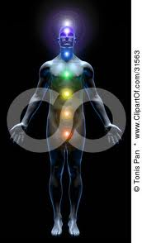
it’s not about doing
it’s about BEING

Slide 40
what’s next?
practice, practice, practice
get ready for the Certification Assessment Program in September

